Slide 1


CITS1003 Introduction to Cybersecurity [4] Threats exercise
Dr Zhi Zhang

Slide 2
Malware evasion:
encrypts/modifies its code to evade the detection by anti-malware
Common evasion techniques:
oligomorphic
polymorphic
metamorphic

Slide 3
Malware
Malware
body
pattern

Slide 4
Malware
Malware
Anti-malware pattern detection
body
pattern

Slide 5
Malware
Anti-malware pattern detection
Malware
pattern
encrypted body

Slide 6
Malware
single decryptor
pattern
Malware
pattern
Anti-malware pattern detection
encrypted body

Slide 7
Oligomorphic Malware
n decryptors
e.g., 10^2
pattern

Slide 8
Oligomorphic Malware
n decryptors
e.g., 10^2
pattern
Malware replicates itself and infects others

Slide 9
Oligomorphic Malware
n decryptors
e.g., 10^2
pattern
Malware
encrypted body
decrypted body
encrypted body
Malware replicates itself and infects others

Slide 10
Oligomorphic Malware
n decryptors
e.g., 10^2
pattern
Malware
encrypted body
decrypted body
encrypted body
Malware replicates itself and infects others
Same?

Slide 11
Oligomorphic Malware
n decryptors
e.g., 10^2
pattern
Malware
encrypted body
decrypted body
encrypted body
Malware replicates itself and infects others
Different

Slide 12
Oligomorphic Malware
Anti-malware pattern detection
n decryptors
e.g., 10^2
pattern
Malware
encrypted body
decrypted body
encrypted body
Malware replicates itself and infects others

Slide 13
Polymorphic Malware
Anti-malware pattern detection
n mutated decryptors
e.g., 10^9

Slide 14
Polymorphic Malware
n mutated decryptors
e.g., 10^9
Malware
original body
encrypted body
decrypted body
encrypted body
Malware replicates itself and infects others

Slide 15
Polymorphic Malware
n mutated decryptors
e.g., 10^9
Malware
original body
encrypted body
decrypted body
encrypted body
Malware replicates itself and infects others
Same?

Slide 16
Polymorphic Malware
n mutated decryptors
e.g., 10^9
Malware
original body
encrypted body
decrypted body
encrypted body
Malware replicates itself and infects others
Same

Slide 17
Polymorphic Malware
Malware
pattern
pattern
original body
decrypted body
Same
What can we do to detect polymorphic malware?

Slide 18
Polymorphic Malware
What can we do to detect polymorphic malware?
dynamic decryption: provide a sandbox environment to execute malware and identify the pattern of critical code at run-time
Malware
pattern
pattern
original body
decrypted body
sandbox
Anti-malware dynamic decryption

Slide 19
Oligomorphic and Polymorphic Malware
What can we do to detect oligomorphic or polymorphic malware?
pattern detection: identify patterns/signatures in the decryptors.
dynamic decryption: provide a sandbox environment to execute malware and identify the pattern of critical code at run-time

Slide 20
Metamorphic Malware
Different
Malware
Malware
Malware
Malware
original body
muted body
muted body
muted body
Malware replicates itself and infects others

Slide 21
Metamorphic Malware
pattern detection
dynamic decryption
Different
Malware
Malware
Malware
Malware
original body
muted body
muted body
muted body
Malware replicates itself and infects others

Slide 22
Metamorphic Malware
What can we do to detect metamorphic malware?
heuristic detection: provide a sandbox environment to execute malware and identify suspicious behaviours at run-time.

Slide 23
Malware
Summarize the main characteristics of oligomorphic, polymorphic and metamorphic malware

Slide 24
Malware
Summarize the main characteristics of oligomorphic, polymorphic and metamorphic malware
oligomorphic: it decrypts itself with a limited number of decrpytors each time it infects others.
polymorphic: it decrypts itself with an unlimited number of decrpytors each time it infects others.
metamorphic: it mutates itself significantly each time it infects others.

Slide 25
Malware
What are the benefits of studying evasive malware?
e.g., the attacker’s perspective/the defender’s perspective

Slide 26
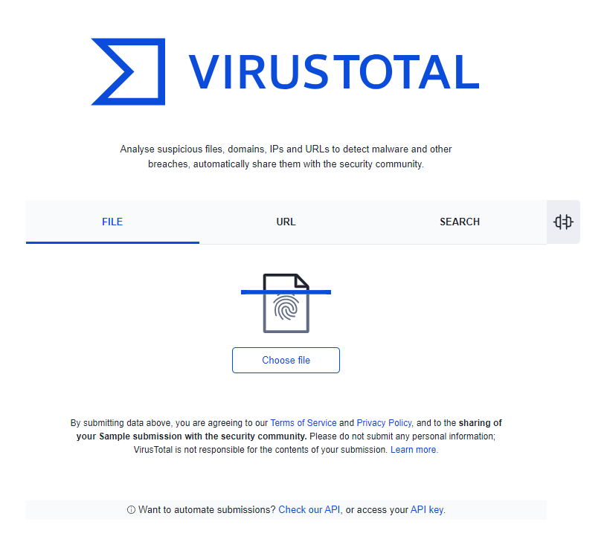
Malware Detection
Virus Total is a website that provides free online malware scanning.
It is a collection of no less than 60 malware-detection engines.
Provides a comprehensive view of whether a file or website is malicious.

Slide 27
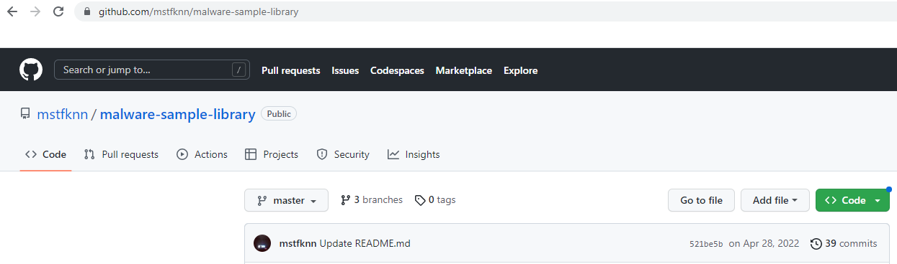
Malware Detection
https://github.com/mstfknn/malware-sample-library

Slide 28
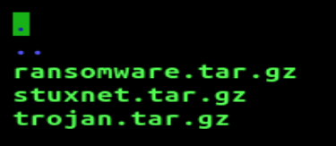
Malware Detection
https://github.com/mstfknn/malware-sample-library
3 malware samples are downloaded

Slide 29
Malware Detection
How does VirusTotal detect malware?
Can VirusTotal detect all malware? Why or Why not?

Slide 30
Malware Detection
How does VirusTotal detect malware?
e.g., it submits a given file or URL to many anti-malware engines, which apply different techniques for scanning. The techniques can be pattern detection, dynamic analysis, etc.

Slide 31
Malware Detection
How does VirusTotal detect malware?
e.g., it submits a given file or URL to many anti-malware engines, which apply different techniques for scanning. The techniques can be pattern detection, dynamic analysis, etc.
Can VirusTotal detect all malware?

Slide 32
Malware Detection
How does VirusTotal detect malware?
e.g., it submits a given file or URL to many anti-malware engines, which apply different techniques for scanning. The techniques can be pattern detection, dynamic analysis, etc.
Can VirusTotal detect all malware?
e.g., mutated/sandbox-aware malware.

Slide 33
Malware Detection
Yara is a rule-based signature matching tool.
It is an open-source project.
It uses a set of rules to generate a pattern/signature.
The signature describes characteristics of malware, e.g., file size, file hash, certain strings of code, etc.

Slide 34
Malware Detection
Demo Time: use our docker container
sudo docker run -it --rm uwacyber/cits1003-labs:ai-malware

Slide 35
Malware Detection
Demo Time: use our docker container
sudo docker run -it --rm uwacyber/cits1003-labs:ai-malware
apt-get install yara
git clone https://github.com/Yara-Rules/rules.git

Slide 36
Malware Detection
List a few practical use-cases of YARA in cybersecurity

Slide 37
Malware Detection
List a few practical use-cases of YARA in cybersecurity
e.g., malware detection/intrusion detection/system monitoring

Slide 38
Malware Detection
Ember is an AI-based signature detection tool.
It is an open-source project.
It uses a deep-learning-based model to predict whether a given file is malicious.
The file type is limited to windows-specific PE (portable executable).

Slide 39
Malware Detection
Demo Time: use our docker container
sudo docker run -it --rm uwacyber/cits1003-labs:ai-malware

Slide 40
Malware Detection
What is the main difference between Yara and Ember?
What can be done to improve them?

Slide 41
Malware Detection
What is the main difference between Yara and Ember?
e.g., Yara is rule-based while Ember is DL-based.
Yara supports multiple file types while Ember is limited to one type.

Slide 42
Malware Detection
What is the main difference between Yara and Ember?
e.g., Yara is rule-based while Ember is DL-based.
Yara supports multiple file types while Ember is limited to one type.
What can be done to improve them?

Slide 43
Malware Detection
What is the main difference between Yara and Ember?
e.g., Yara is rule-based while Ember is DL-based.
Yara supports multiple file types while Ember is limited to one type.
What can be done to improve them?
e.g., Yara’s key limitation: rule-based signature matching, which makes it hard to work against advanced mutation techniques.
Ember’s key limitation: its dataset used to train its DNN model is obsolete.

